Slide 1

AtliQ Hardwares
CONSUMER GOODS AD_HOC INSIGHTS (EDL)

Slide 2
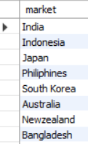
Question 1- Provide the list of markets in which customer "Atliq Exclusive" operates its business in the APAC region.
Output
AtliQ exclusive works in 8 different countries or markets including India.

Slide 3
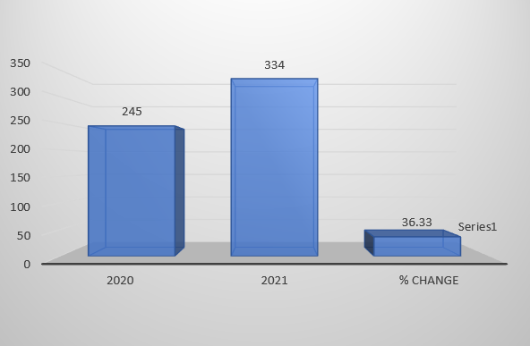

Question 2- What is the percentage of unique product increase in 2021 vs. 2020?
Output
The percentage change for unique products increase in AtliQ Hardwares from 2020 to 2021 is 36% which is pretty good for the company as it is innovating and introducing new products in the market and for the smooth running , they must get the reviews of the consumers to know about their experience using the product and to understand their requirements better. This would be helpful for the company in future to introduce new products.

Slide 4
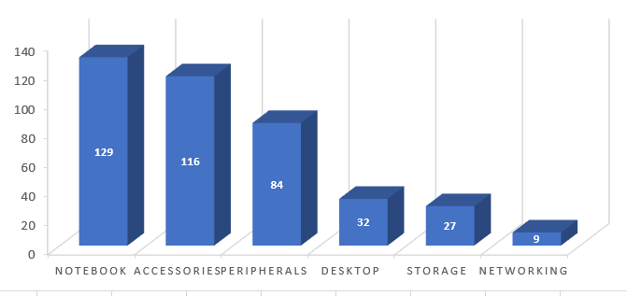
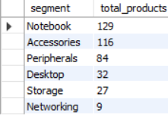
Question 3- Provide a report with all the unique product counts for each segment and sort them in descending order of product counts.
Output
As we can see that for the Notebook, Accessories, Peripherals, the unique products are in a good quantity with an average of almost 110 . But there are very few unique products in the other three segments for the product line with the average of only 22.6
So, from this the company will understand which segment needs further improvement and innovation.

Slide 5
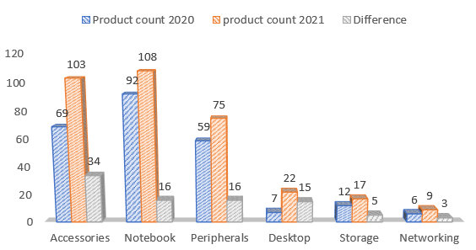
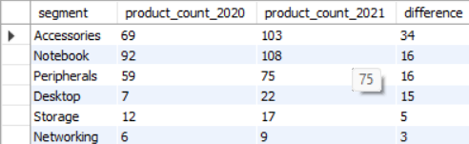
Question 4- Follow-up: Which segment had the most increase in unique products in 2021 vs 2020?
Output
Total products in the first four categories is good as it is increasing in count from 2020 to 2021.
In the last two segments, the products count is very low and its increase too, so this could be a reminder for the management to take decisions for the expansion of storage and networking products too.

Slide 6
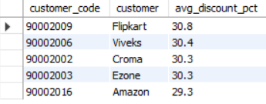
Question 6- Generate a report which contains the top 5 customers who received an average high pre_invoice_discount_pct for the fiscal year 2021 and in the Indian market.
Output
Top 5 customers having average high pre invoice discount percentage.
This could help the management to identify that which customers are paying early in order to get the trade discount as much as possible.
This is beneficial for both the customer and the business.

Slide 7
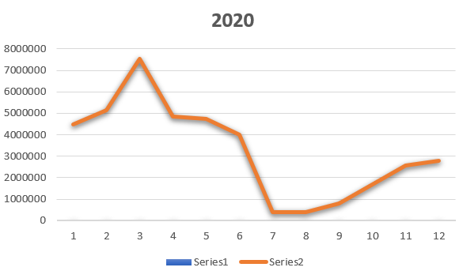
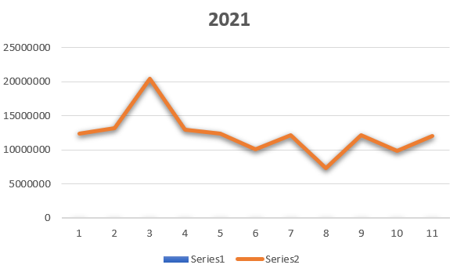
Question 7- Get the complete report of the Gross sales amount for the customer “Atliq Exclusive” for each month.
As we are able to see here above that in both the years the highest gross sales were in the months of February, March, November and December and other months are contributing low than these months.
So the management could get an idea about the months that are highly contributing and those that are contributing lower.

Slide 8
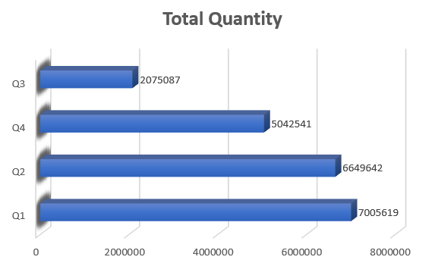
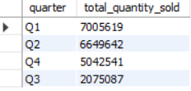
Question 8- In which quarter of 2020, got the maximum total_sold_quantity? The final output contains these fields sorted by the total_sold_quantity.
Output
The maximum quantity of goods are sold in the first quarter of the year as the financial year of AtliQ Hardwares starts from September and it does business in India too and these months are the festive months in India.
This is helpful to know about the most successful quarter for sales in business.

Slide 9

Question 9- Which channel helped to bring more gross sales in the fiscal year 2021 and the percentage of contribution? Output
Output
Out of the 3 channels, we can see that the Retailer is Contributing the most with 73% followed by direct and distributor with 15% and 11% respectively.
There is a huge difference between the gross sales of Retailer and the other two categories and this could be an indicator that there is a need of improvements for these categories.

Slide 10
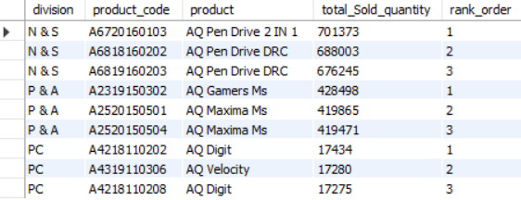
Question 10- Get the Top 3 products in each division that have a high total_sold_quantity in the fiscal_year 2021?

